Slide 1
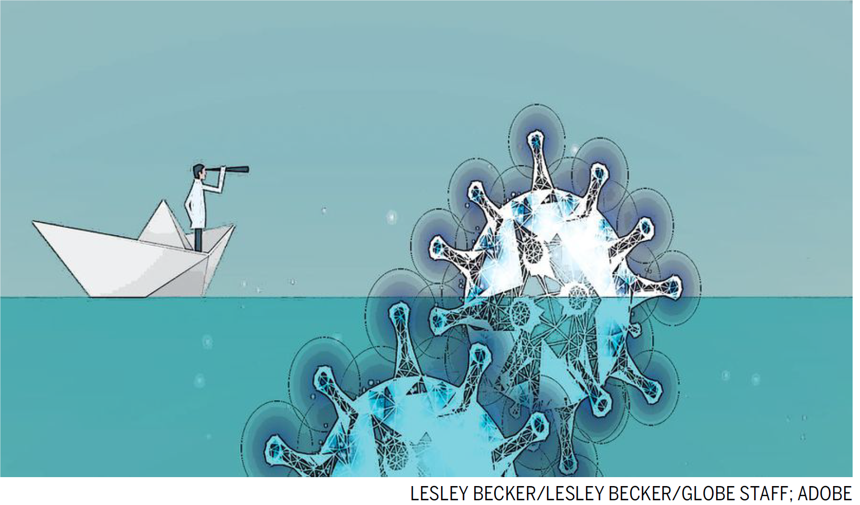
Hysteresis in globalisation: Thinking ahead on trade after Covid19
Richard Baldwin
Graduate Institute, Geneva

Slide 2
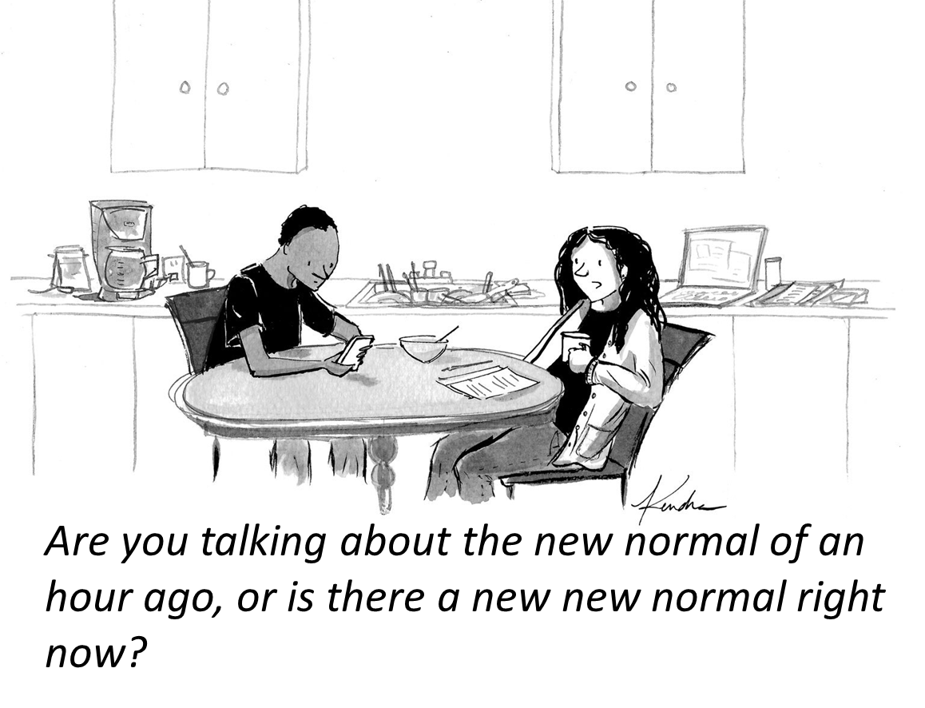
Talk in three parts
This shock is different
Thinking about permanent changes
Applications to trade

Slide 3
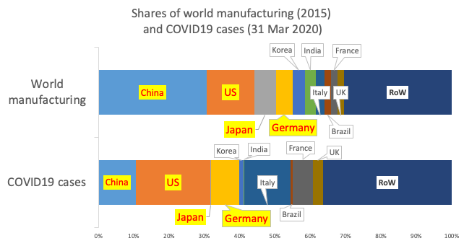
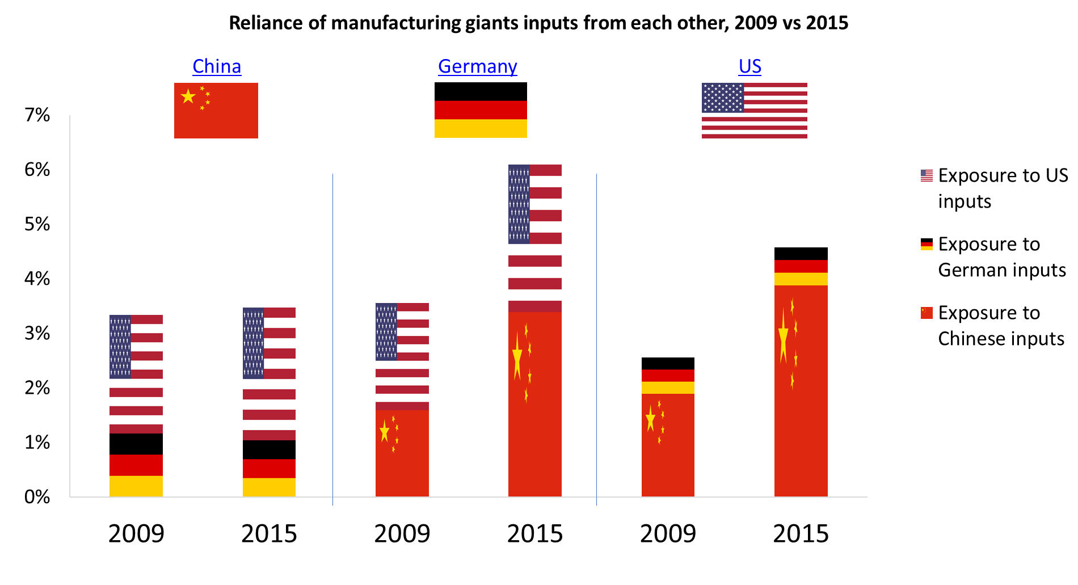
This time is different
Nature of the “COVID concussion”
As in 2008-09:
Sudden, severe, synchronised
New elements:
Hit all the biggest traders/manuf within 2 months
Manufacturing more integrated
…

Slide 4
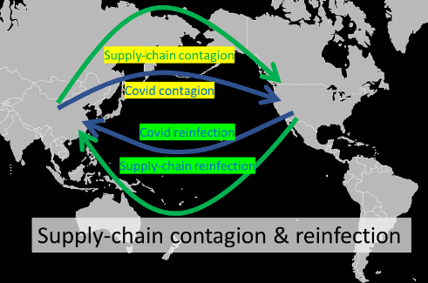
Supply chain contagion & reinfection

Slide 5
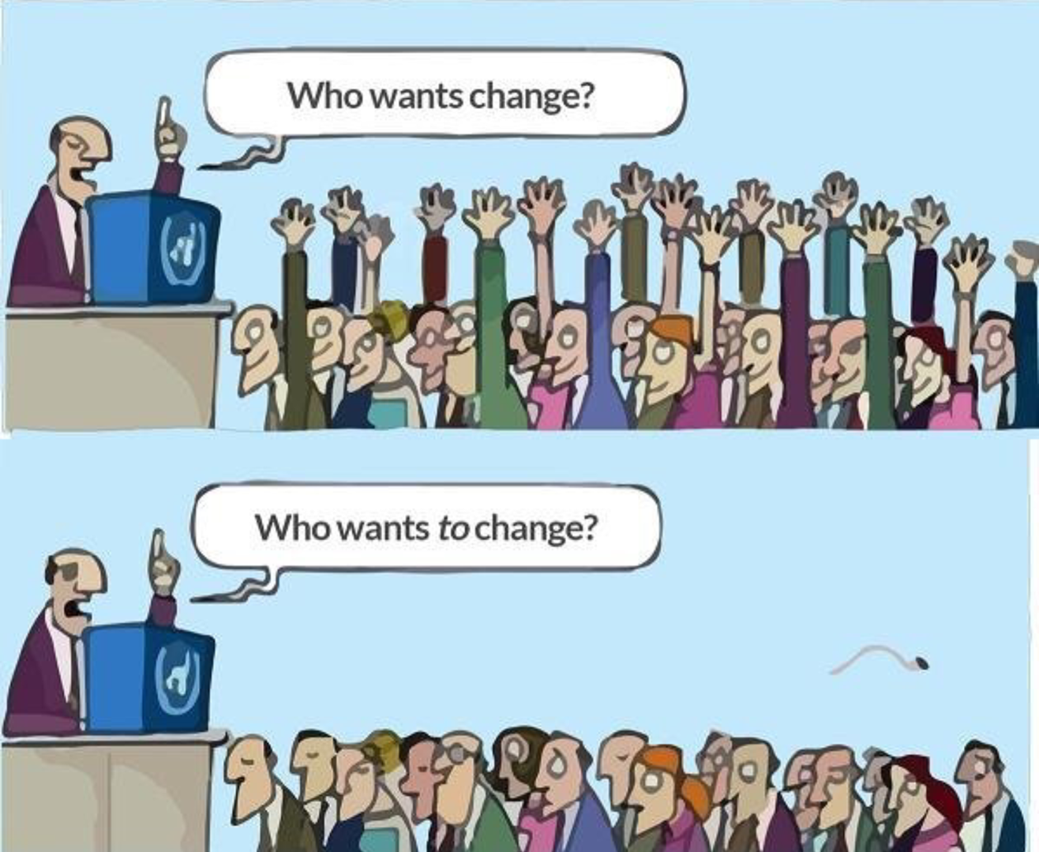
Thinking about change
Persistent change
  “Woolly and wishful” thinking
  Structural models of why things are the why they are now

Slide 6
Hysteresis in Trade (1986)
Hysteresis = Path-dependence
  Temporary shocks cause permanent change only in hysteretic models
What sorts of models/economic-logics admit hysteresis?
Consider 5 classes of models

Slide 7
I. Multiple equilibrium models
Shock knocks situation from one eq’m to another
Game theory, e.g the “meeting game”
In NEG-like models
Network models (multiple stable network configurations possible)
B A | In person | On phone
In person | 2, 2 | 1, 1
On phone | 1, 1 | 3, 3

Slide 8
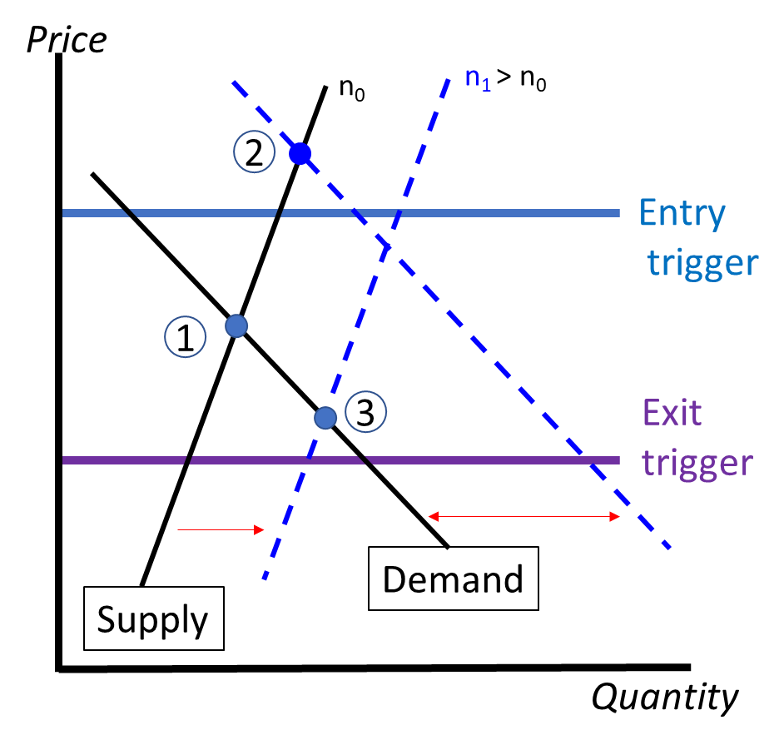
II. Sunk-cost hysteresis models
(Baldwin 1988 AER, Baldwin and Krugman 1989 QJE, Dixit 1989 QJE, Bertola and Cabellero 1994 REStud)

Slide 9
Information sets
Hysteresis in information sets

Slide 10
IV. Mindsets & risk attitudes
Psychology and shocks:
  ‘Depression Babies’ & equity holdings, Malmendier and Nagel (2011)
Habit formation
  Boldrin, Christiano, & Fisher, 2001; Campbell & Cochrane, 1999, habit formation and risk aversion

Slide 11
V. Political economy organisational capital
Juggernaut model of trade liberalisation (Baldwin and Robert-Nicoud 2008)
Protection for Sale with sunk-cost entry/exit in import competing and exporting industries
Liberalisation -> entry of exporters & exit of import competitors
MEC with exporters also lobbying
Marginal economic damage to welfare
Marginal producer surplus (import competitors)

Slide 12
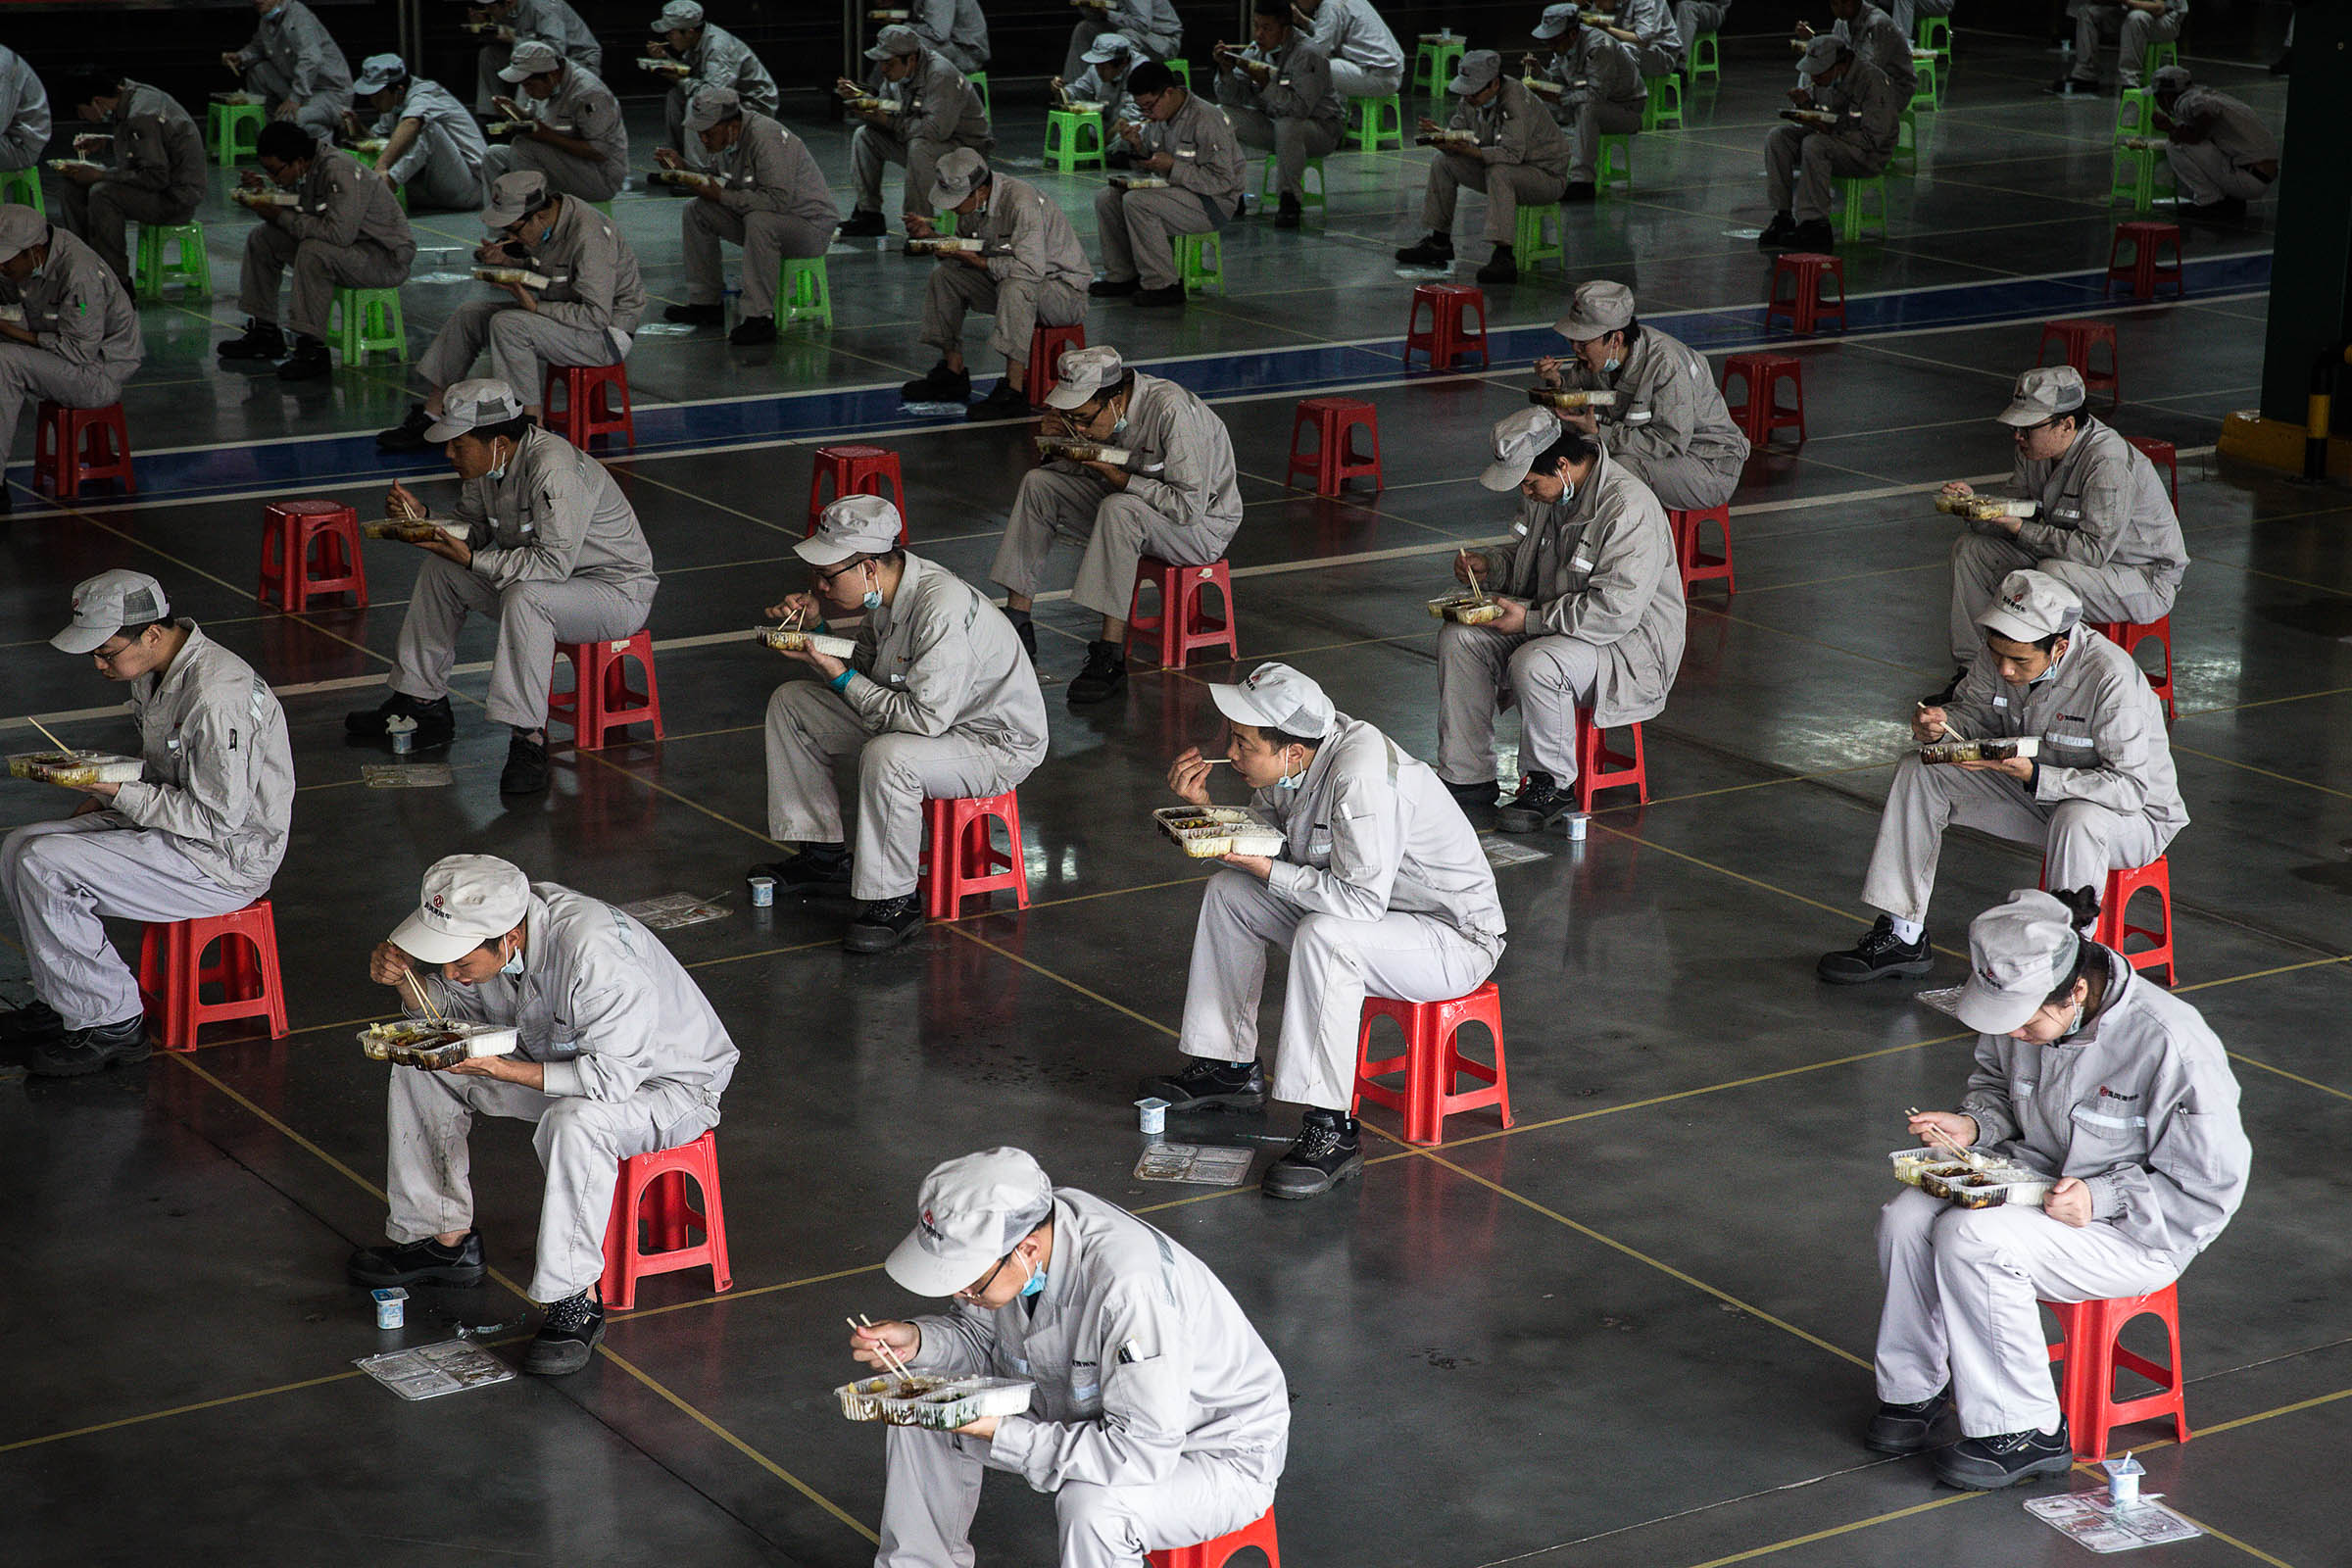
Applications to trade post-Covid

Slide 13
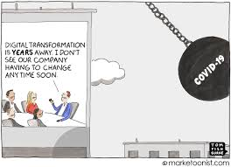
Trade in services – 3rd Unbundling
Massive sunk cost investment in remote work
  Equipment, training, cooperation & data pushed online
Coordination problems solved by force (multiple eq’ms)
Organisation changes changed by force
Telecommuting -> “telemigration” (Baldwin 2019)

Slide 14
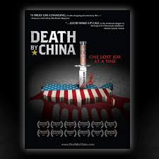
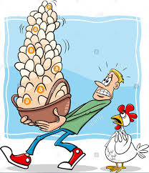
Supply chains & trade as insurance
Navarro: an executive order that would aim to reduce the United States’ dependency on foreign manufacturers for medicine.
“Don’t keep all your eggs in one basket – even if that basket is at home”

Slide 15
Diversified supply chains + stockpiling
Robustness in supply sourcing
  Information sets changed
What really changed?
  Floods, earthquakes, GFC, etc
  Permanent change will require government subsidies, government administered or mandated stockpiles, or regulatory requirements
Reward (cost savings)
Indifference curve
Risk-reward frontier
Risk of disruption

Slide 16
Intellectual property rights for drugs
2017 WTO amendment to TRIP agreement
  HIV, TB, malaria drugs – generics allowed from 3rd nations to poor nations without licencing
Likely to happen again with COVID-linked drugs
NB: GATT history on export restrictions & national security concerns

Slide 17

End – thanks for listening

